Slide 1




Breaking The
Emission
Curve
Noor Ali

Slide 2



Introduction
Climate change is one of the most urgent challenges facing our planet, driven largely by the rapid rise in greenhouse gas emissions.
Emissions mainly from burning fossil fuels for energy, transportation, and industry.

Slide 3




Impact
Melting Polar Ice
Melting Arctic sea ice forces polar bears onto land for longer periods, separating them from their main food source, seals, and leading to starvation, reduced reproduction, and increased mortality

Slide 4

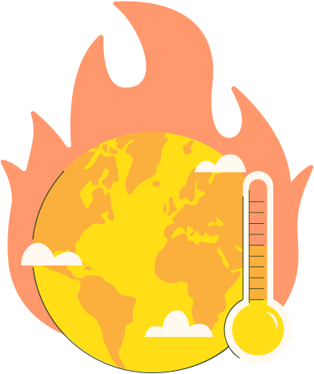
Problem Statement
📈 Greenhouse Gases Emissions Continue To
Rise from 36.3 in 2021 to 57.4 gigatons in 2022.
🔥 Heavy Reliance On Fossil Fuels.
🎯 To Explore The main Drivers Of Emissions And Suggest Solutions For A Cleaner Energy Future.

Slide 5




objectives
Study how emissions change over time with renewable and fossil fuel use.
Identify top and low emitters to see which countries contribute most and least to global emissions.
Look at how much energy those countries use and where it comes from.
Track per capita emissions over time to understand individual impact and progress.
Suggest ways to reduce emissions using cleaner energy.

Slide 6



Target Audience
Environmental ministries or government agencies
Sustainability and ESG departments
Environmental NGOs
Energy companies

Slide 7



Data Overview
Years
Locations
1900 - 2022
306
Energy types
Renewable
fossil fuel
nuclear
World Energy Consumption

Slide 8
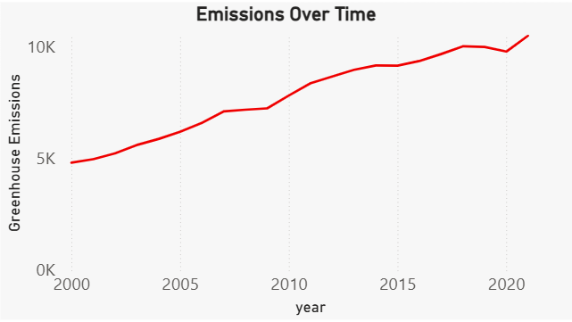
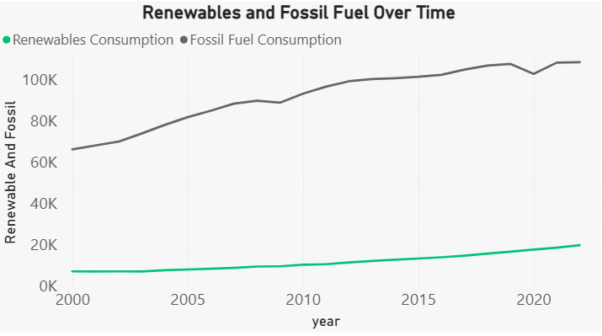
Greenhouse gas
Emission

Slide 9
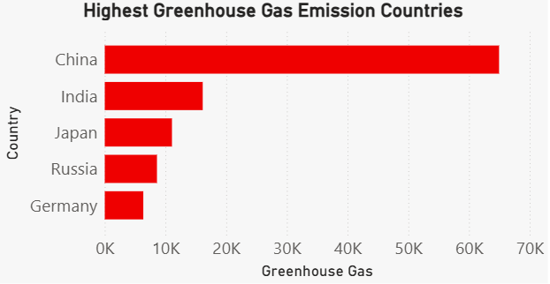
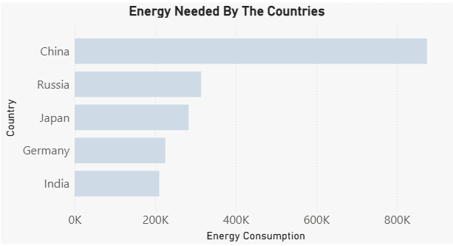
Highest
Greenhouse emitter

Slide 10
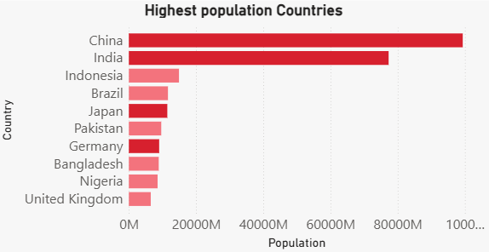
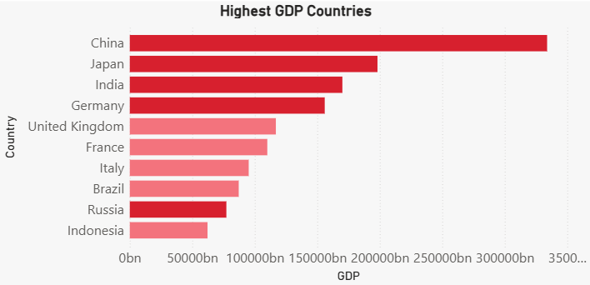
causing
Factors

Slide 11
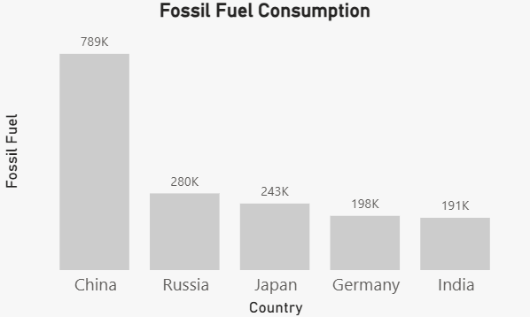
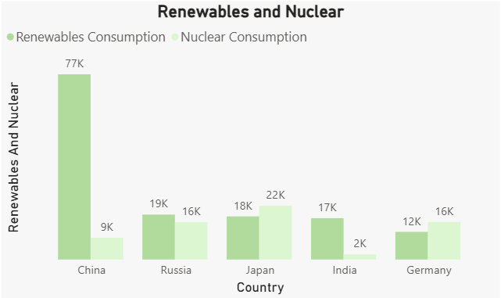
Energy
Usage

Slide 12
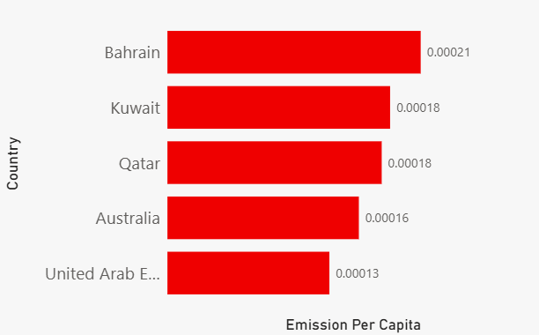
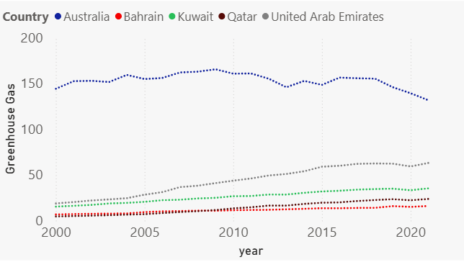
per capita
highest emitter

Slide 13
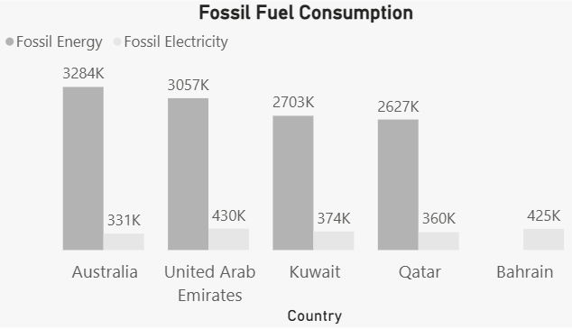
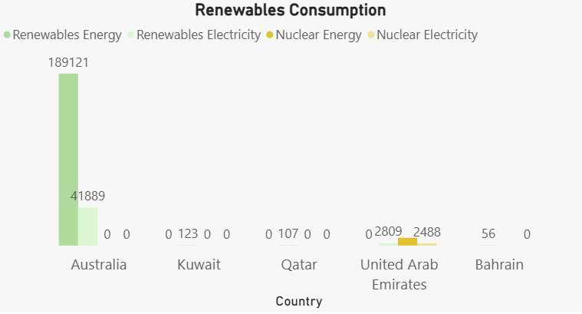
per capita
energy usage

Slide 14
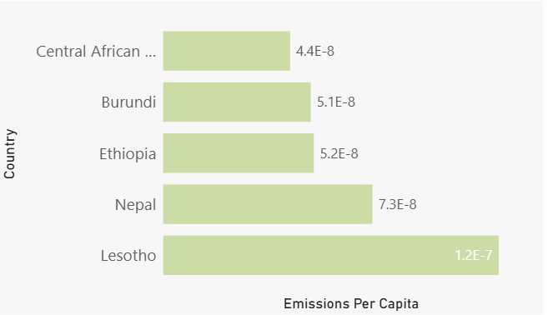
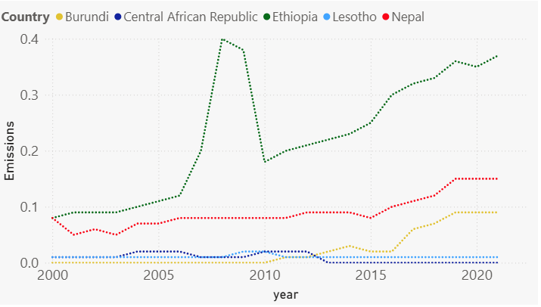
per capita
lowest emitter

Slide 15
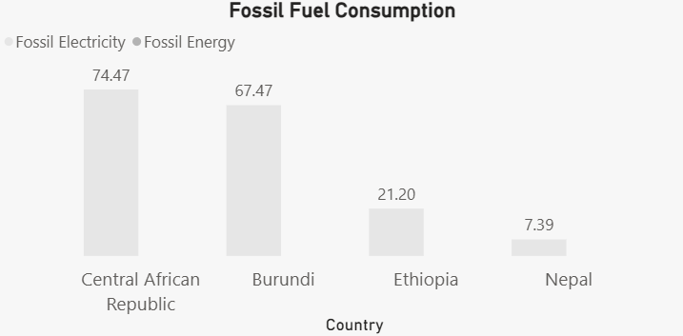
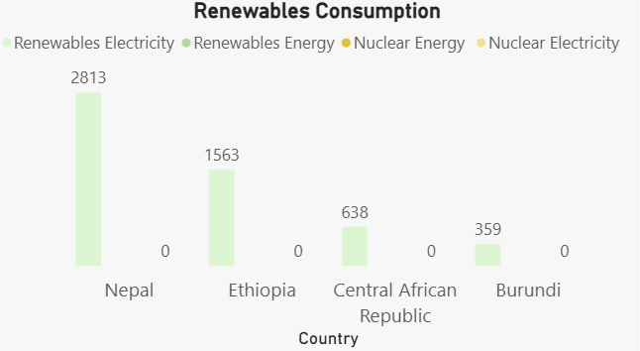
per capita
energy usage

Slide 16
Conclusion
🌍 Emissions are rising: Global greenhouse gas emissions more than doubled since 2000.
⚡ Fossil fuels dominate: Renewable energy is growing but still far behind fossil fuels, which remain the main source of emissions.
🏭 Top emitters: China, India, Japan, Russia, and Germany lead in emissions, energy use, GDP, and population.
👤 Per capita matters: Small countries like Bahrain, Qatar, and Kuwait have very high per-person emissions.
🌱 Low emitters use renewables: Countries with the lowest emissions rely more on clean energy and less on fossil fuels.

Slide 17


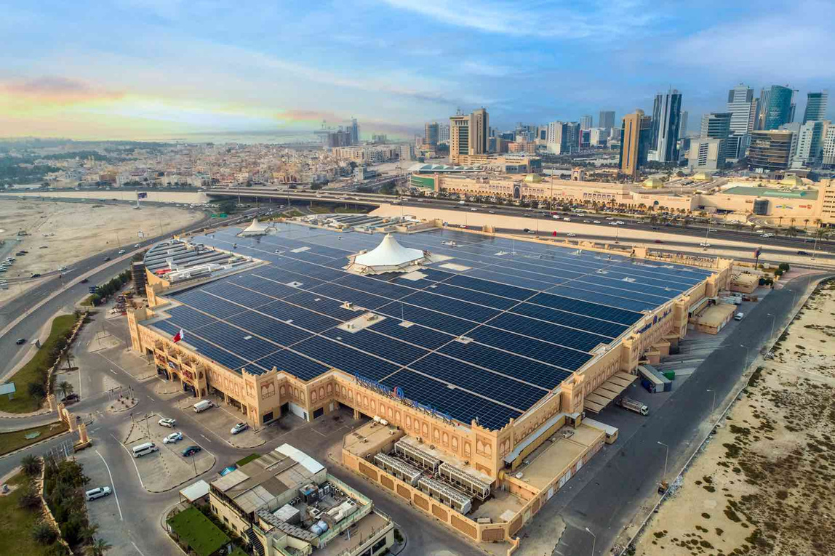

bahrain
Efforts
☀️ Solar energy
🌳 Mangrove tree
♻️ 2060 Zero emissions

Slide 18

Recommendation
solution
Reducing Emissions: Transitioning to renewable energy
☀️ Solar , 💨 Wind , 💧 Hydro , 🌿 biofuel
☢️ Nuclear
Enhance global cooperation and climate policies.
Encourage sustainable lifestyles.

Slide 19


🚗 Choose sustainable transport – Walk, bike, use public transit.
🌱 Plant trees — they capture carbon, improve air quality.
🔌 Save energy – Turn off unused lights and reduce heating/cooling waste.
Impact oF
Humans

Slide 20
Thank you

